Slide 1

Rish
HEMOTRACK
Smart Blood Bank Management Solution
Presented By - Team 12
Anagha Dinesh
Arsha B
Gauri Parvati
Rishika Das

Slide 2

INTRODUCTION
Developing a smart blood bank monitoring system involves several necessary steps, including hardware setup and software integration, each of which is crucial for seamless functionality.

Slide 3
Impact of non-availability in blood banks
Increased mortality - Insufficient blood supplies can lead to delays in life-saving medical
procedures
Healthcare disruptions - Blood shortage can disrupt routine medical care and emergency
response efforts
Community health risks - Effects pose broader public health risks by limiting capacity to respond to
emergencies
Our solution is to develop a comprehensive blood bank monitoring system using IoT technologies,
including NRF modules for wireless communication and load cell sensors for precise stock
measurement.

Slide 4

HARDWARE
LOAD CELL
To sense weight, we use a load cell that generates the difference in weight.
BLUETOOTH MODULE
The signal is transmitted using BLE.

Slide 5
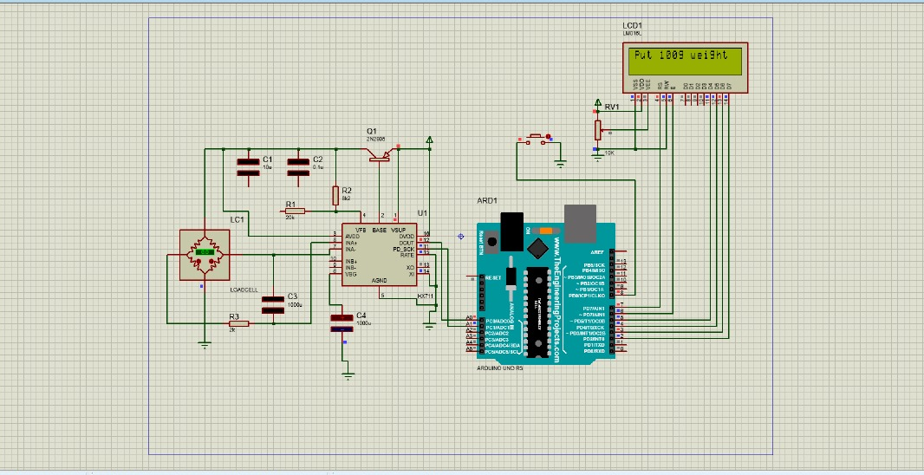
sis
SIMULINK

Slide 6
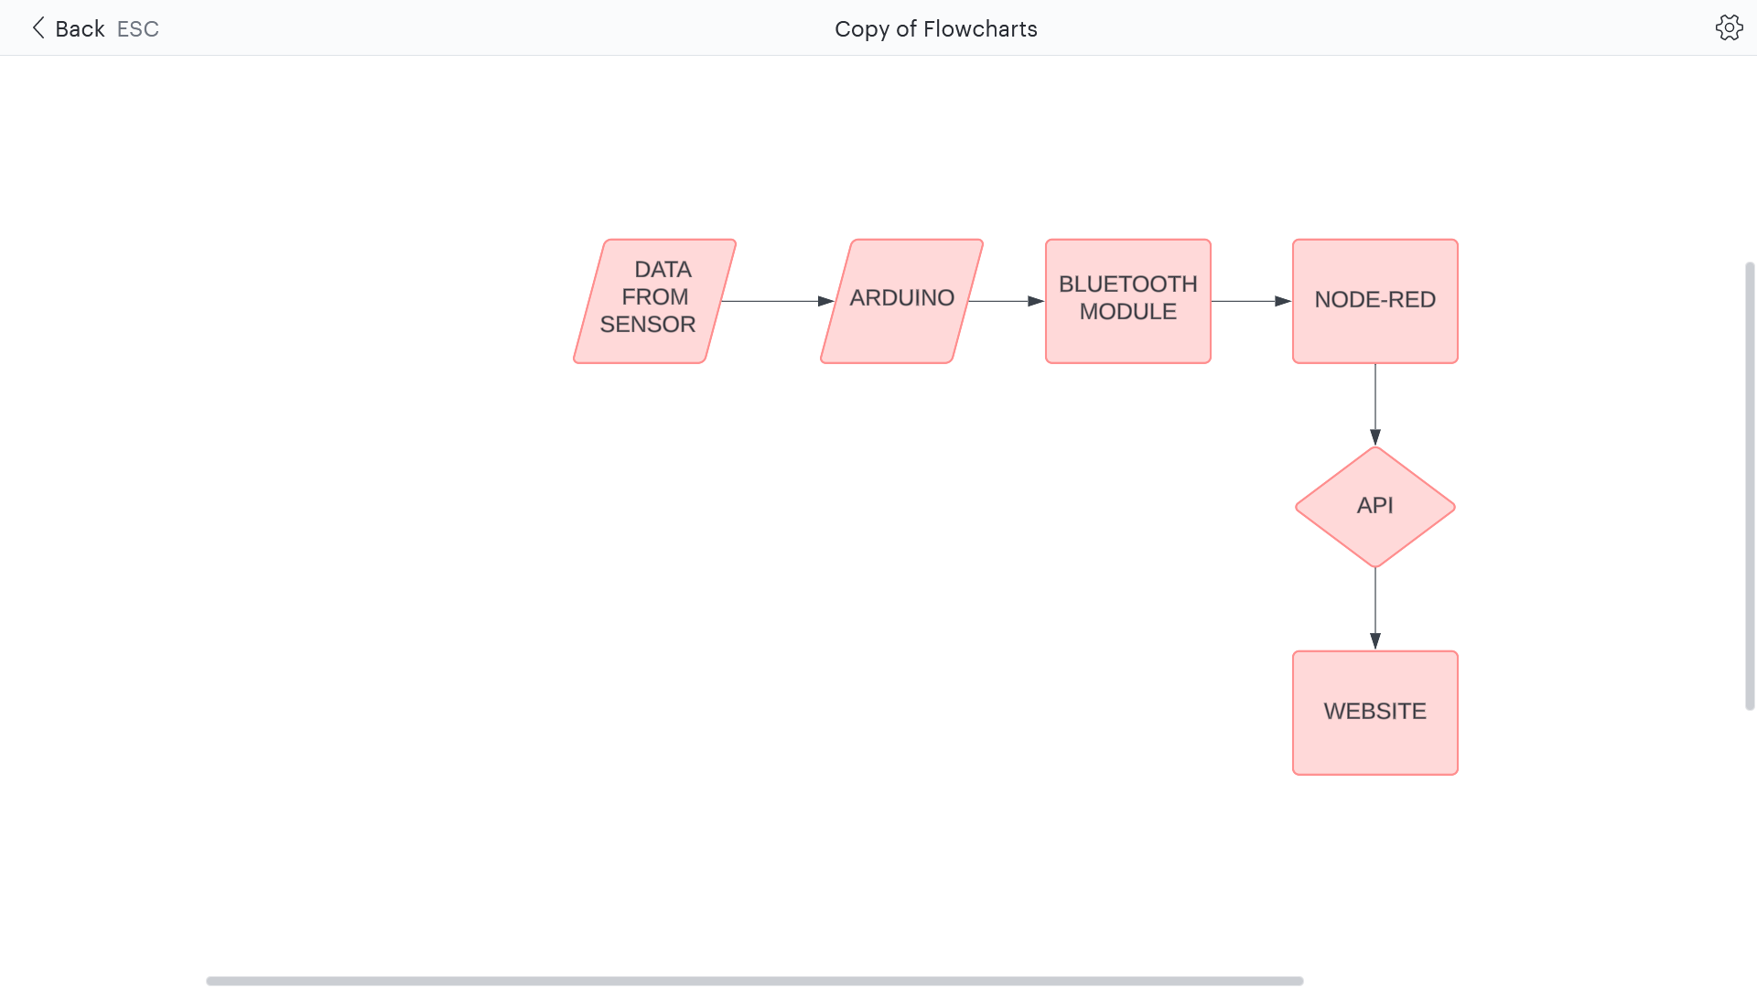
FLOWCHART

Slide 7
User Interface Design
Figma
Cloud based design tool for creating user interfaces, websites and app prototypes
Allows multiple users to collaborate in real time
Offers features like vector editing, prototyping and version control

Slide 8
Innovations
Lora module
Long range: Offer extended communication range, enabling connectivity over several kilometres
Low power: Designed for energy efficiency, allowing devices to operate on battery power for extended periods without frequency recharging
Adaptive data rate: Support dynamic adjustment of communication parameters like data rate and transmit power, optimizing performance for varying environmental conditions

Slide 9

Conclusion
An intuitive interface that allows blood bank staff to navigate and access critical information
such as inventory levels , alerts. The development and implementation of the project aimed at
detecting blood shortages in a blood bank represent a significant step forward in ensuring
availability of life saving resources

